Slide 1

A Day in the Life of an Endangered Animal
By: Sofia Stein
Notes:
Hi Instructor,
Look in this box to find tips and directions for the slides in this presentation template. Presentations are a way for families to understand all the hard work that went into their student’s project this week!
SUGGESTED DAILY DIRECTIONS FOR INSTRUCTOR:
Tuesday - Wednesday: Complete Slides 3 & 4 and add photos or screenshots of the students progress on their project.
Thursday: Complete Slides 5 through 7. Add Class photo to Slide 2.
Friday: Complete Slide 8 and add a photo. Before Concept Café, take time to review your students’ presentations for typos.
PRO-TIPS:
Twice daily, remind students to take screenshots of what they’re working on. The screenshots will be stored in the student folder (if it’s set up correctly through Toolkit).
You can find camp photos through the Photo bookmark in Chrome/Firefox or at http://photos.idtech.com/Alexa! (Let the students know your location and the dates of camp so they can find photos quickly)

Slide 2

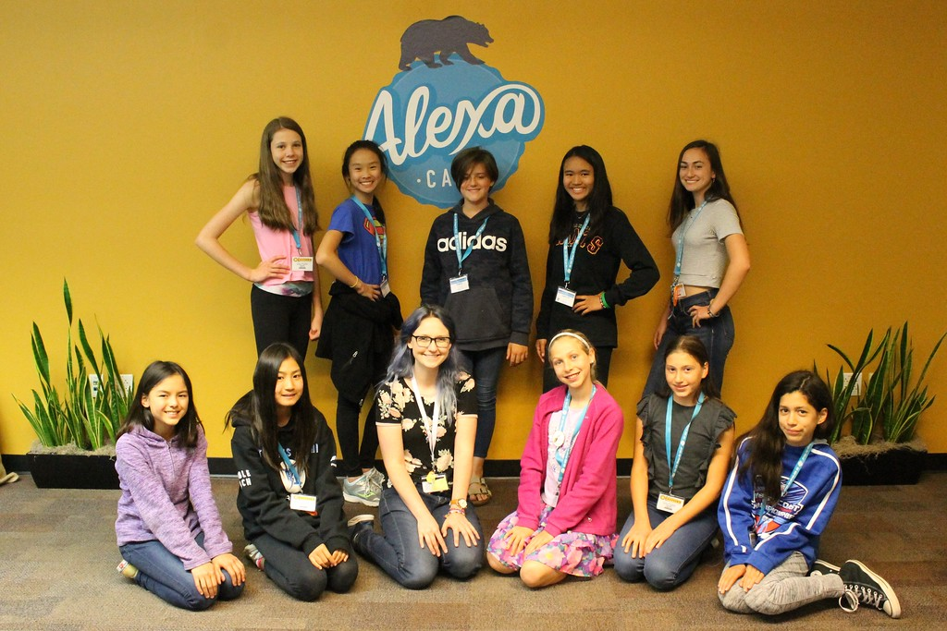

UC Berkeley
Code Cafe: Development with Java
Type Dates Here (ex: June 22nd – June 27th)
Notes:
DIRECTIONS:
Have students find their class photo on the Photo Website and save it to their folder.
PRO-TIP: Let the students know your location and the dates of camp so they can find photos quickly.
CHANGE: REPLACE IMAGE > UPLOAD FROM COMPUTER > STUDENT FOLDER or DESKTOP (wherever it is saved)

Slide 3


My Social Movement
Endangered Animals
My Social movement is to raise awareness of how humans affect endangered animal lives.
I chose this movement because I really want to help people realize how what they do every day that affects the special endangered animals all around the world in bad and good ways.
Notes:
DIRECTIONS:
Students list at least 2 things about their social movement and why they chose it for their final project.
IMAGE SUGGESTIONS:
Student should use screenshots from their student folder here. If you have photos of a student’s project, you can use that instead.

Slide 4

My Concept
A Day in the Life
I was inspired to create this project because I want to educate people about how they affect animals' lives, especially endangered animals.
How are you incorporating technology to solve this problem?
I'm making a text adventure that has you as the animal and it shows you how animals are affected by humans.
Notes:
DIRECTIONS:
Students can use this slide to help them create their 30-second pitch on Friday. Make sure they delete the example text.
IMAGE SUGGESTIONS:
Student should use screenshots from their student folder here. If you have photos of a student’s project, you can use that instead.

Slide 5

My Journey : Skills Learned
At the beginning...
I used the following skills in my project:
  Else if
  Public void static main (String [] args);
  System.out.println(“”);
The most interesting thing I learned was How to use else if.
Notes:
DIRECTIONS:
Students reflect on the process of creating their final project.
IMAGE SUGGESTIONS:
Student should use screenshots from their student folder here. If you have photos of a student’s project, you can use that instead.

Slide 6

My Journey : The Process
Along the Way...
As I worked throughout the week, I made adjustments and improvements to my project like changing my idea.
The most challenging part of my project was coming up with a plausible idea.
I got feedback/collaboration from my friends, including some great ideas for my project.
Notes:
DIRECTIONS:
Students reflect on the process of creating their final project.
IMAGE SUGGESTIONS:
Student should use screenshots from their student folder here. If you have photos of a student’s project, you can use that instead.

Slide 7

My Journey : The Finish Line!
In the End...
The part of my project I'm most proud of is the storylines.
Next, I'd like to learn more about the java coding language.
Notes:
DIRECTIONS:
Students reflect on the process of creating their final project.
IMAGE SUGGESTIONS:
Student should use screenshots from their student folder here. If you have photos of a student’s project, you can use that instead.

Slide 8
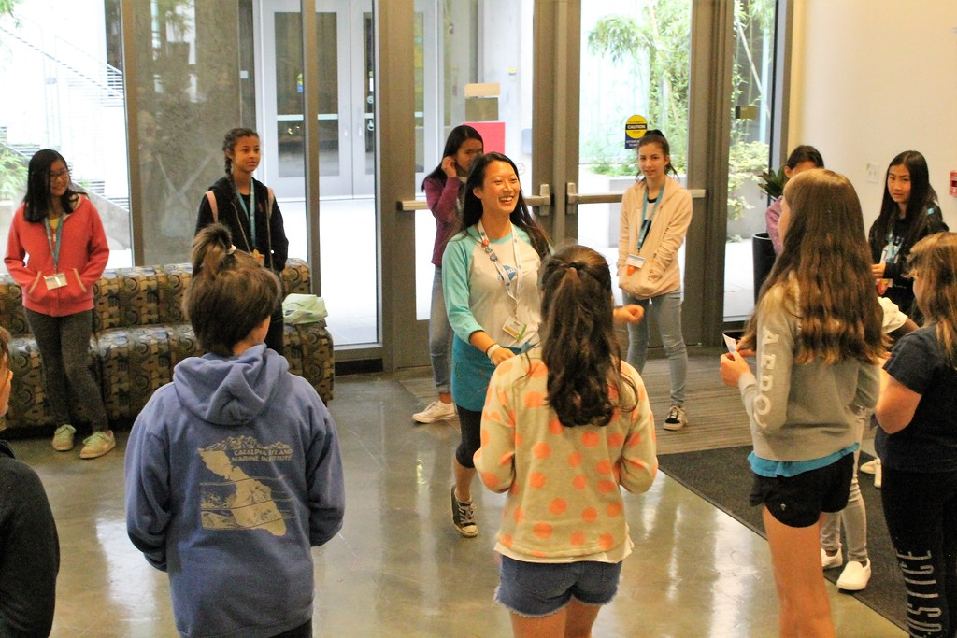
My Favorite Memory
My favorite memory from this week was having fun with friends.
Notes:
DIRECTIONS:
Students find a photo of themselves on the Photo Website (click the bookmark in the browser or head to http://photos.idtech.com/Alexa) and save it to their folder.
PRO-TIP:
On Thursday or Friday, you can do a class brainstorm to remember funny or amazing things that happened during the week. Make a list and have students choose 1-2 things to put on their slide.
IMAGE SUGGESTIONS:
Photos that show the student smiling or engaging are most pleasing to families!

Slide 9




Questions?
Notes:
DIRECTIONS:
This is the end of the slideshow!
It encourages the Family Members to ask questions and learn more about their student’s project.
PRO-TIP
This is a visual cue for YOU that the family is done looking through the presentation and might need some help transitioning to project viewing. Remember to have families circulate to view other students projects after seeing their own students project.

